Slide 1
Different community finding algorithms on classic generated model and real networks
Generate a test bed
Evaluate different algorithms on the test bed
Observe how the algorithms work on the test bed and on real networks

Slide 2
Classical generated model
4 communities (32 nodes each) with random links
Average connections within-community: z_in
Average connections out-community: z_out
z_in + z_out = ⟨k⟩ = 16
==>
When z_out is close to 0, it is easy to identify communities
When z_out is close to 8, the graph becomes homogeneous
When z_out is close to 16, nodes tend to avoid their own community

Slide 3
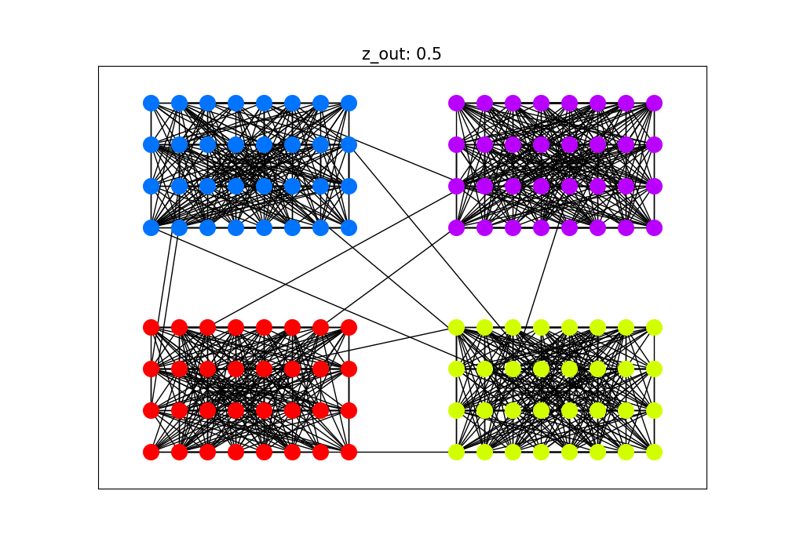
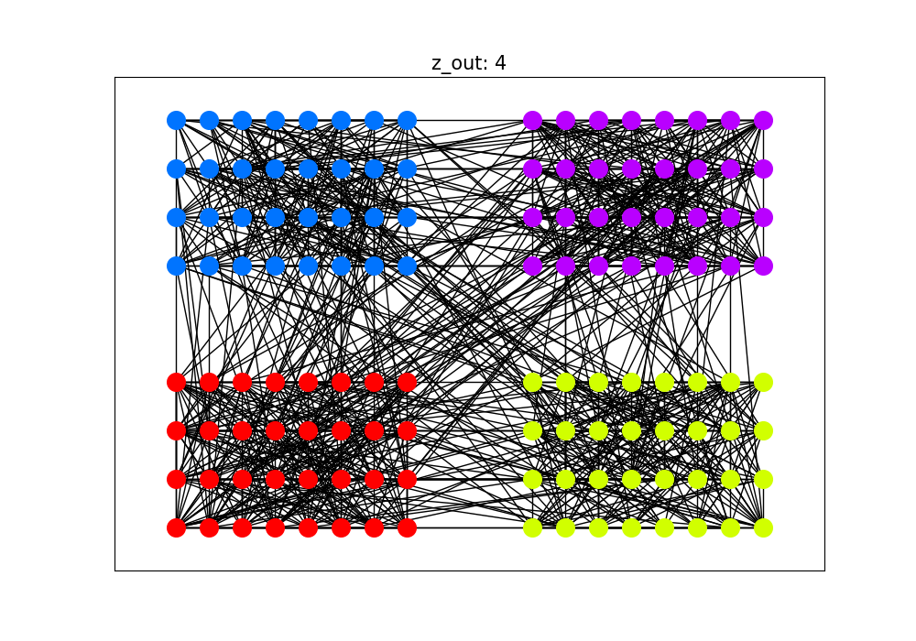
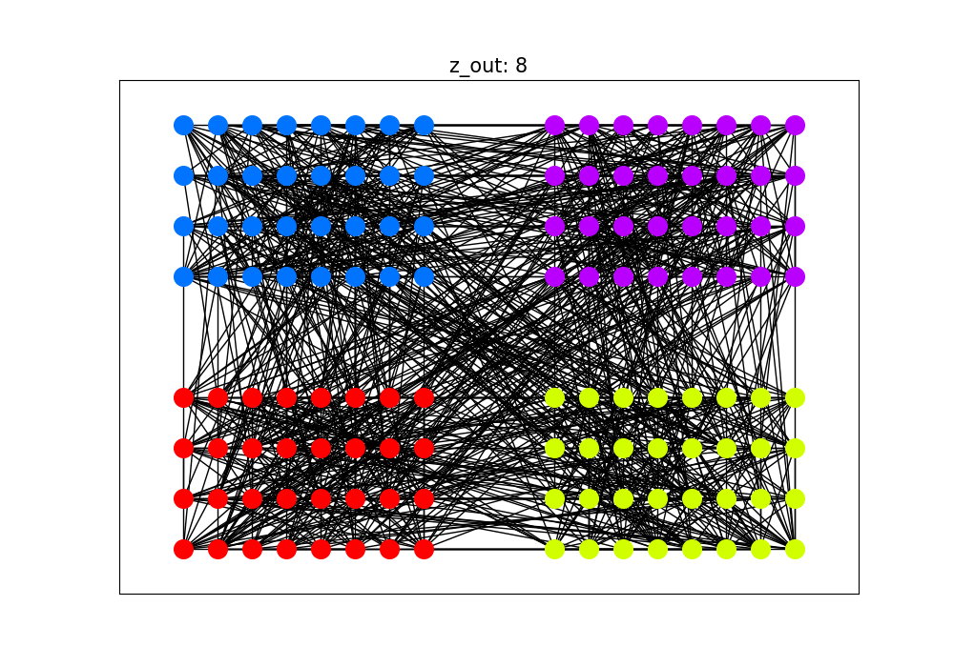
Example of generated model with different z_out
We will generate graph with z_out at:
0.5, 4, 8, 12, 15.5

Slide 4
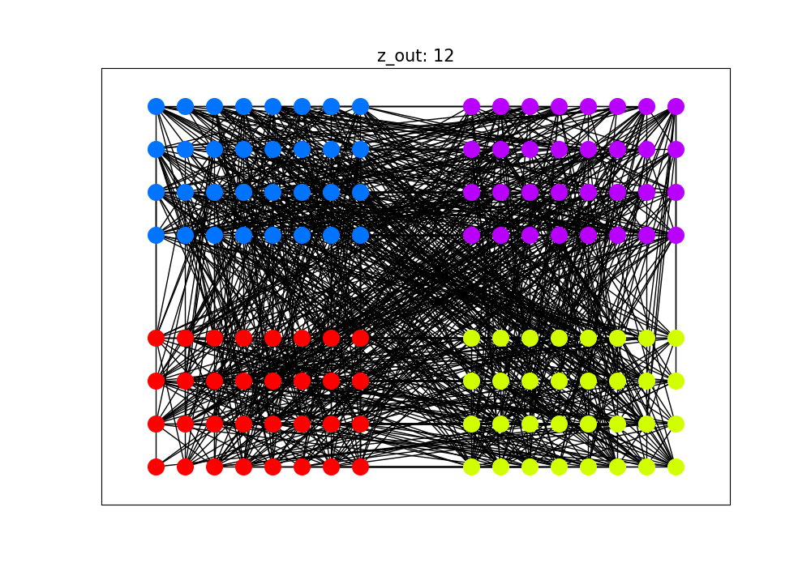
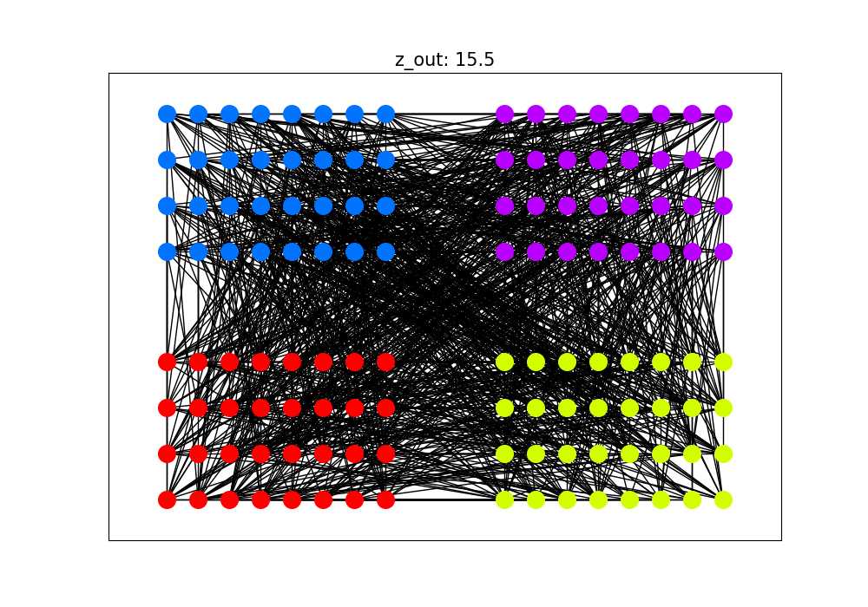

Slide 5
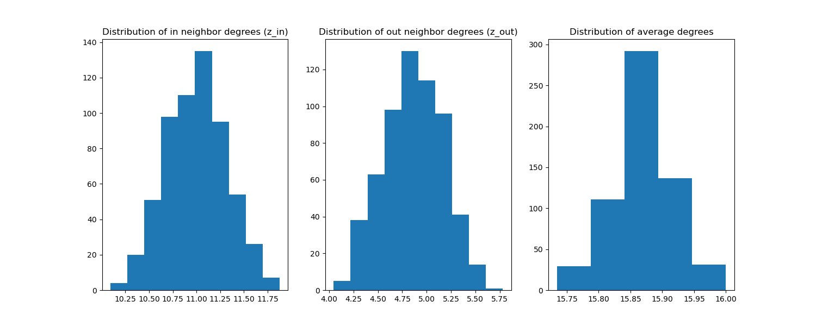
Distribution of degrees
Calculated based on 500 graphs generated at z_out = 5

Slide 6
Different community finding algorithms
Algorithms:
Louvain
Surprises community
Leiden
Walktrap
To evaluate the algorithms, we check the similarity between four ground truth groups and the found groups.
We will observe for different z_out values:
AMI (Adjusted Mutual Information): a metric to compare similarity of two clusterings for a dataset. The higher AMI, the better accuracy algorithm has.
Number of communities found by algorithms
The data will be simulated 100 times to calculated for randomness.
References:
https://en.wikipedia.org/wiki/Louvain_method
https://cdlib.readthedocs.io/en/latest/reference/cd_algorithms/algs/cdlib.algorithms.surprise_communities.html
https://cdlib.readthedocs.io/en/latest/reference/cd_algorithms/algs/cdlib.algorithms.leiden.html
https://cdlib.readthedocs.io/en/latest/reference/cd_algorithms/algs/cdlib.algorithms.walktrap.html
https://en.wikipedia.org/wiki/Adjusted_mutual_information

Slide 7
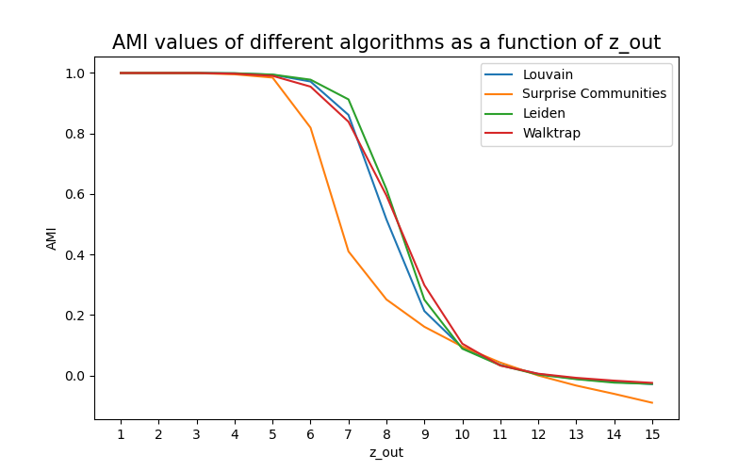
Different community finding algorithms

Slide 8
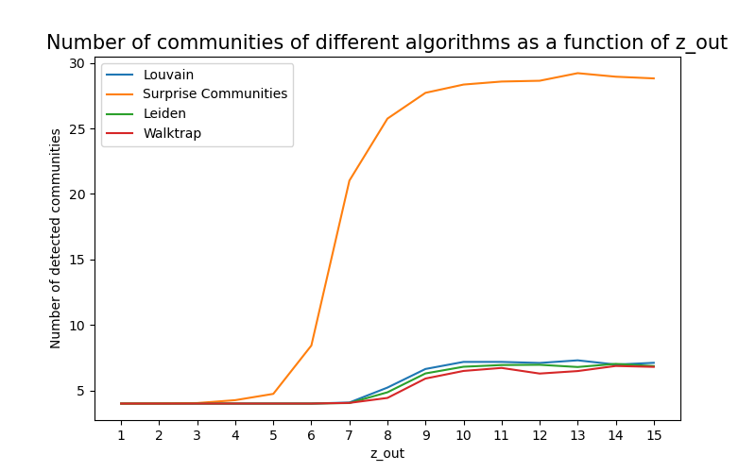
Different community finding algorithms

Slide 9
Observe algorithms on generated networks
The algorithms performances start to degenerate at z_out = 7, thus we will generate graph with z_out at:
0.5, 4, 7, 8, 12, 15.5
Then, we will observe:
The number of communities found
AMI value
The graph of found communities

Slide 10
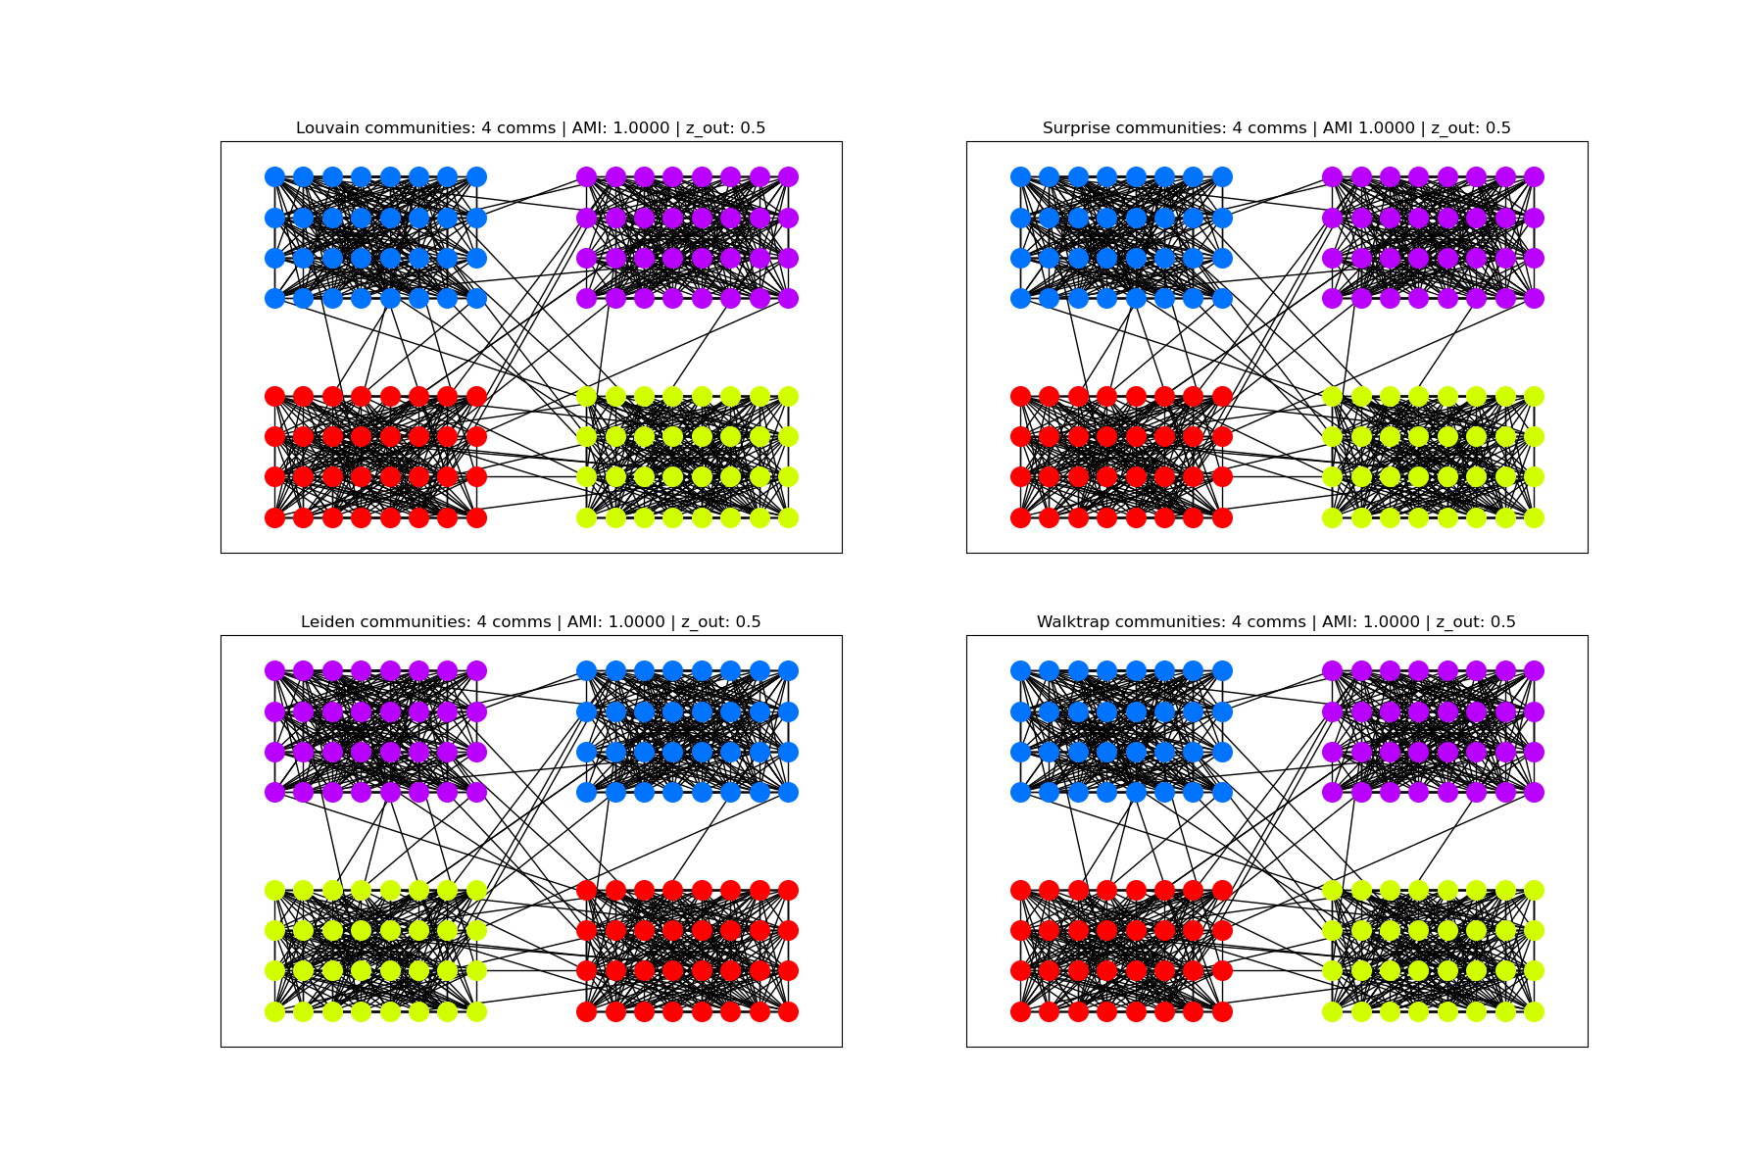

Slide 11
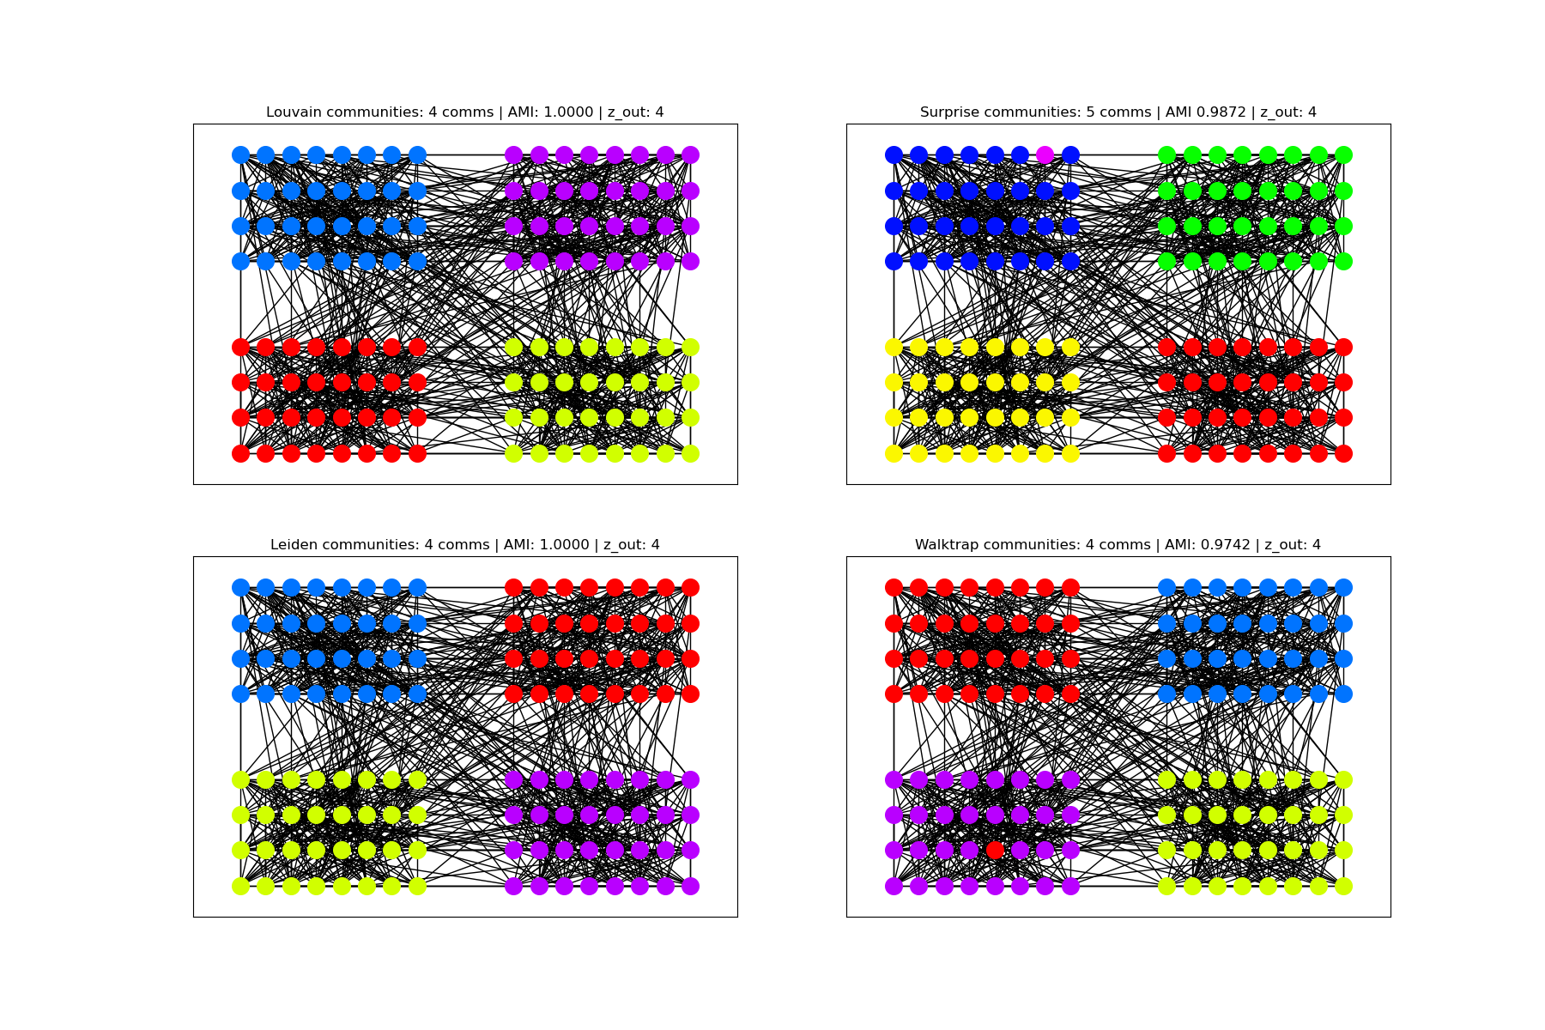

Slide 12
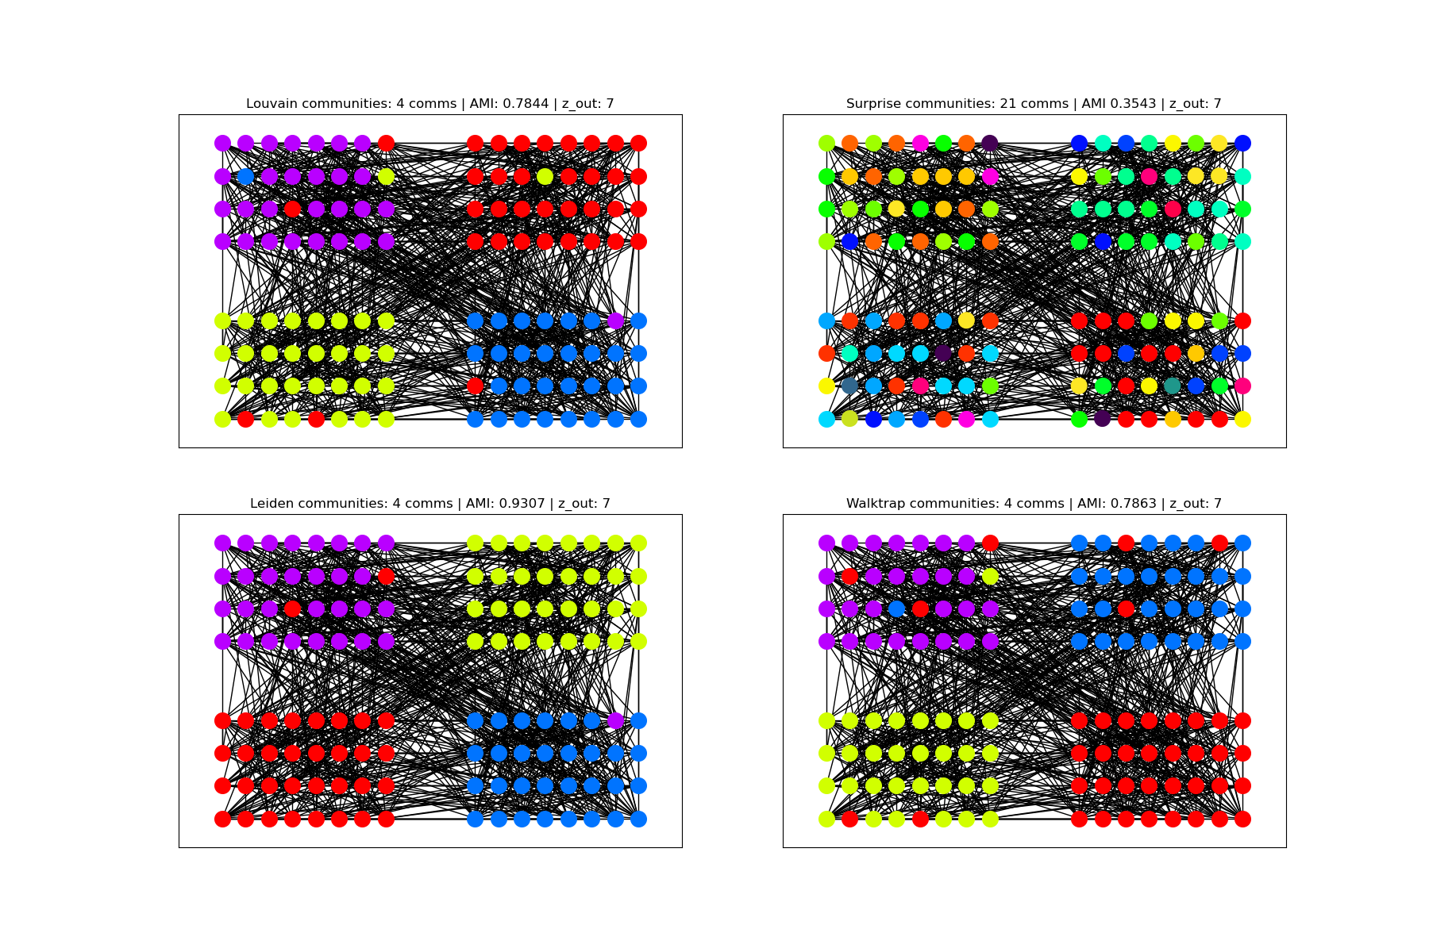

Slide 13
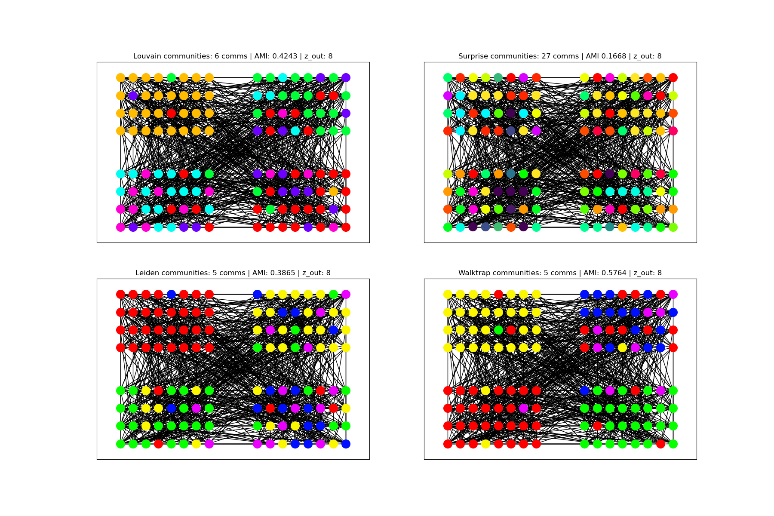

Slide 14
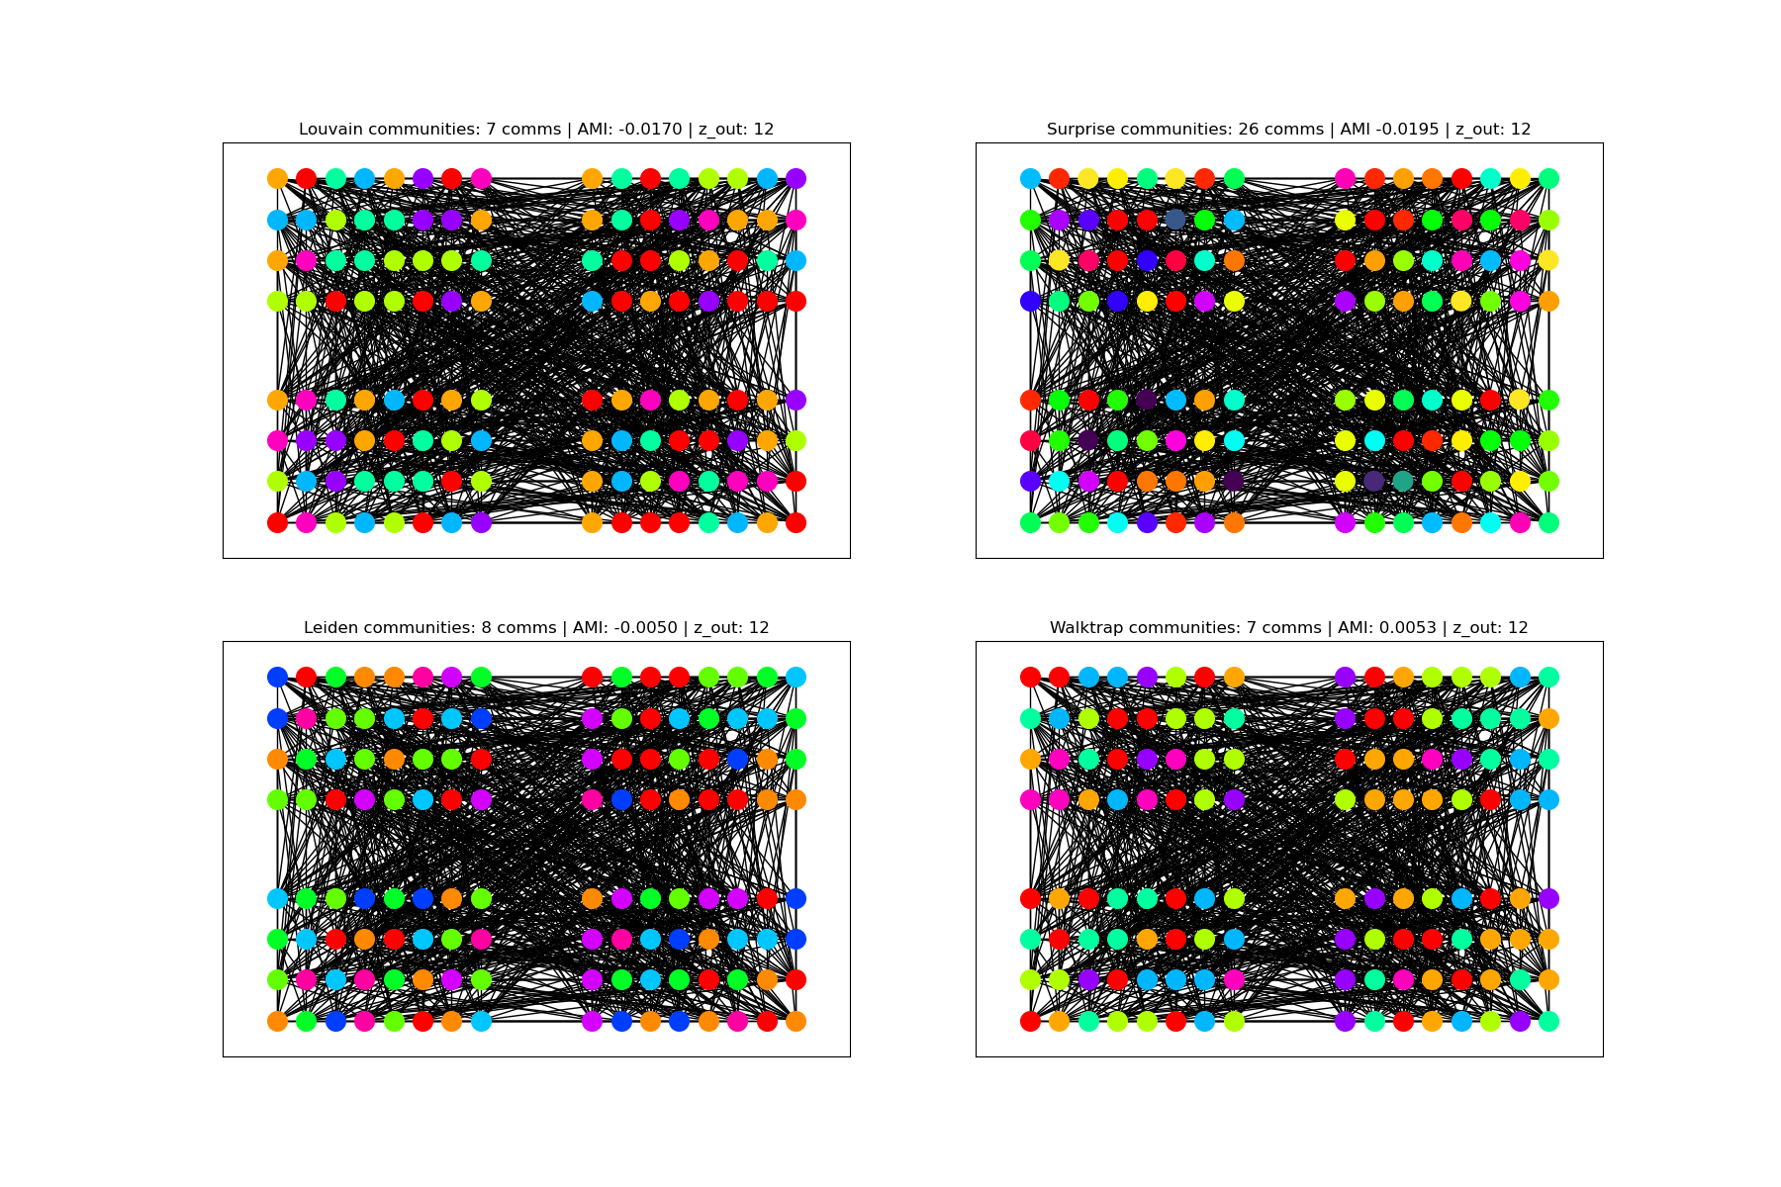

Slide 15
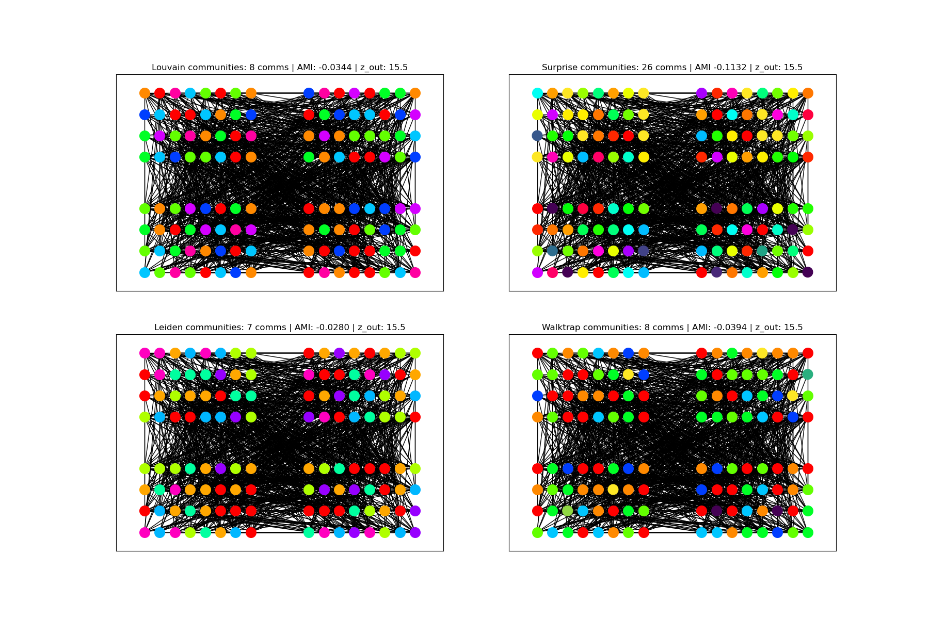

Slide 16
Observe algorithms on real networks
The Zachary’s Karate Club network:
34 nodes
78 edges
2 ground truth communities
The email-Eu-core network:
1005 nodes
25571 edges
42 ground truth communities
References:
https://networkx.org/documentation/stable/reference/generated/networkx.generators.social.karate_club_graph.html#networkx.generators.social.karate_club_graph
https://snap.stanford.edu/data/email-Eu-core.html

Slide 17
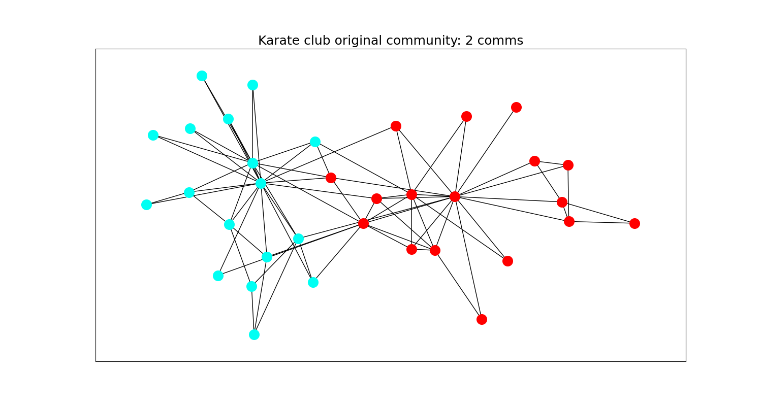

Slide 18
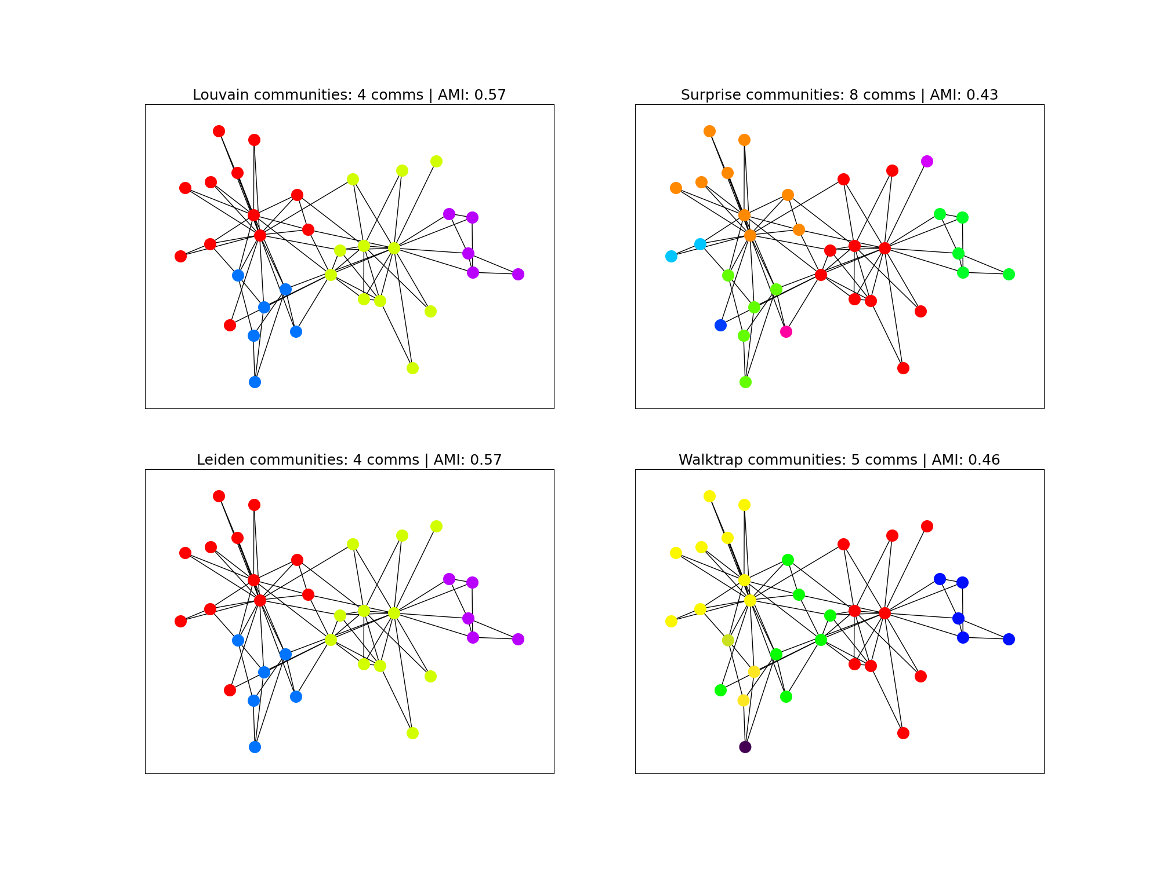

Slide 19
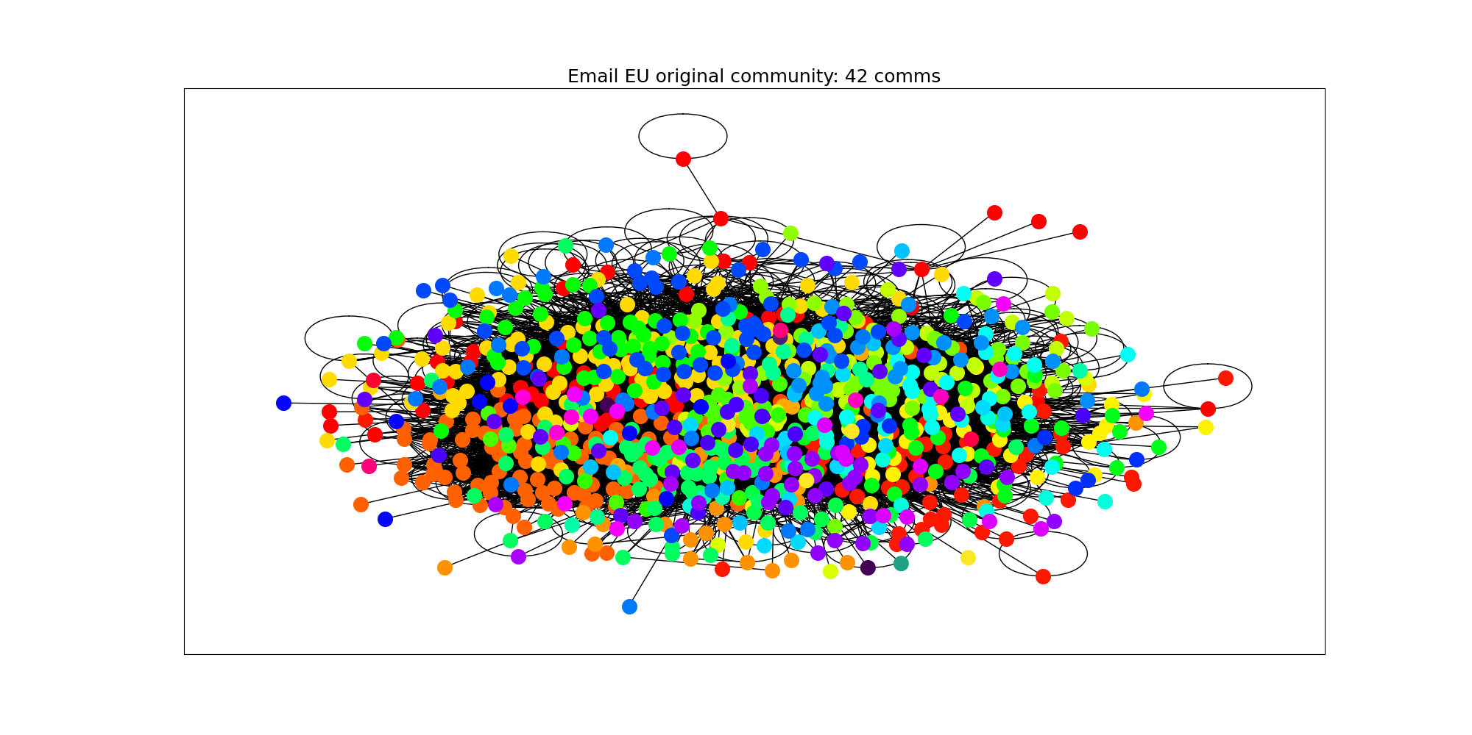

Slide 20
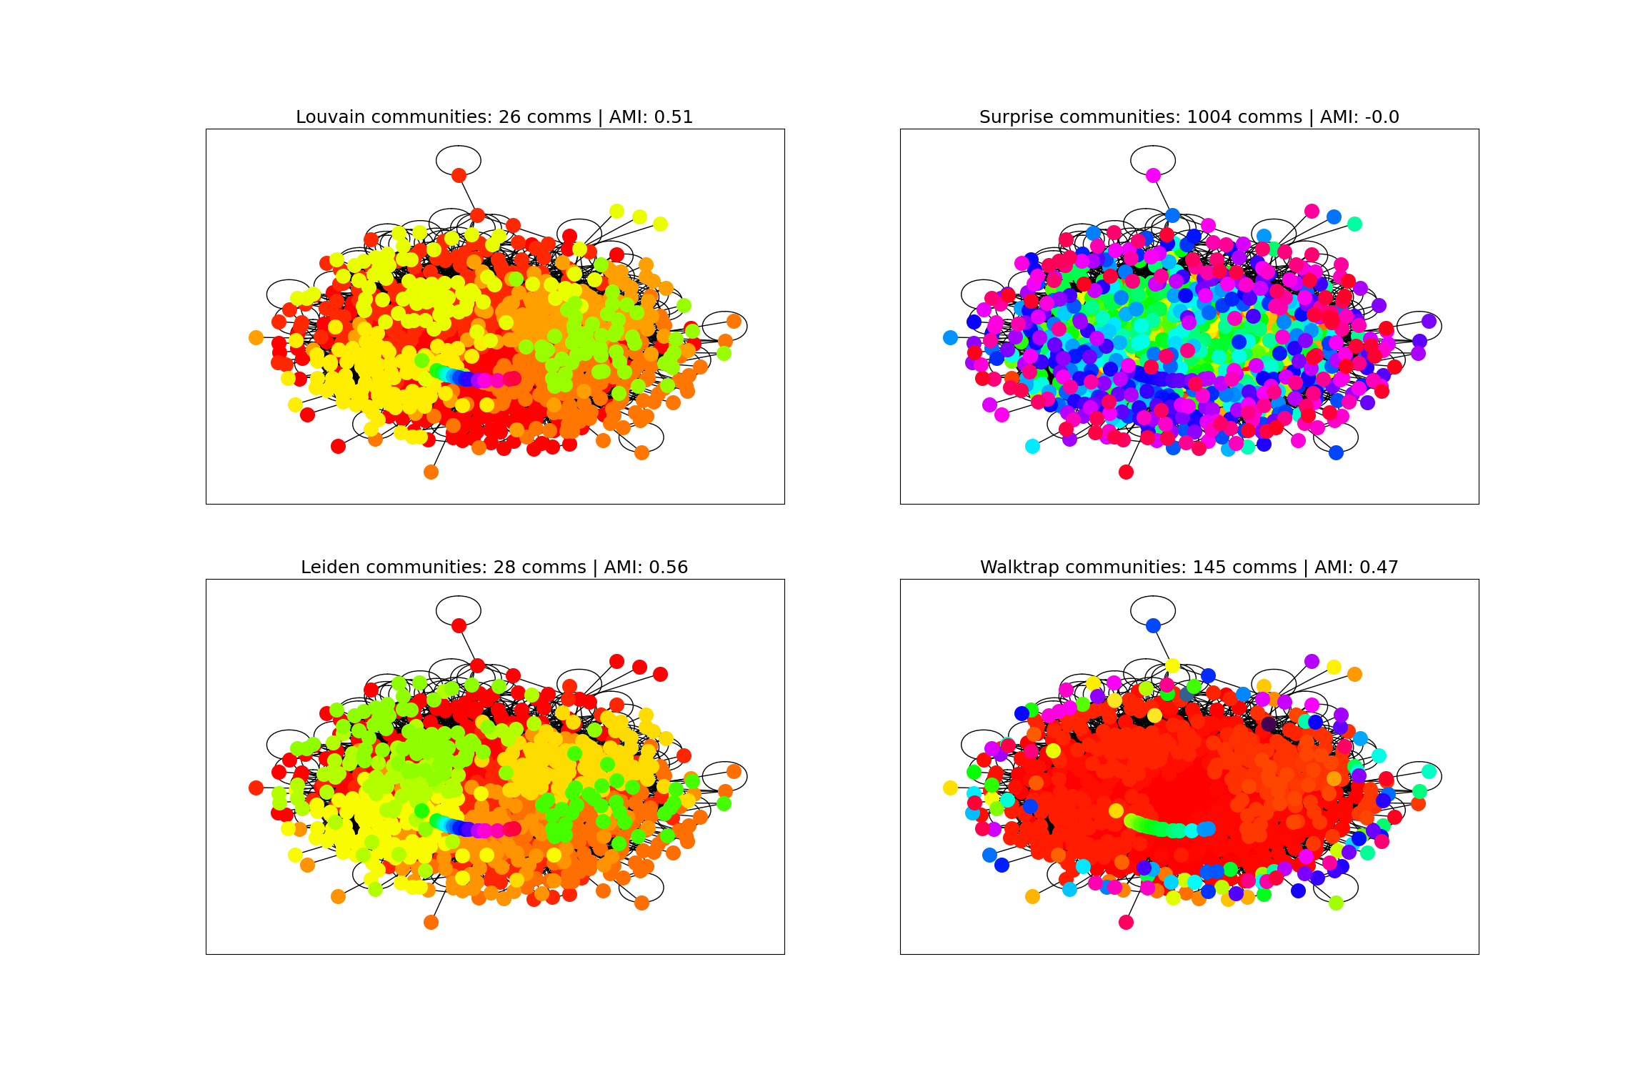

Slide 21
Conclusion
Surprise Community performs worse compared to other algorithms.
It has an earlier drop off point compared to others.
It also tends to explode with the number of algorithms found.
Louvain, Leiden, and Walktrap perform similar on test beds.
However, Walktrap tends to perform slightly worse on real networks.

Slide 22
Thank you for your attention
Q&A

